Slide 1
Soils Support World Food Supply

Slide 2
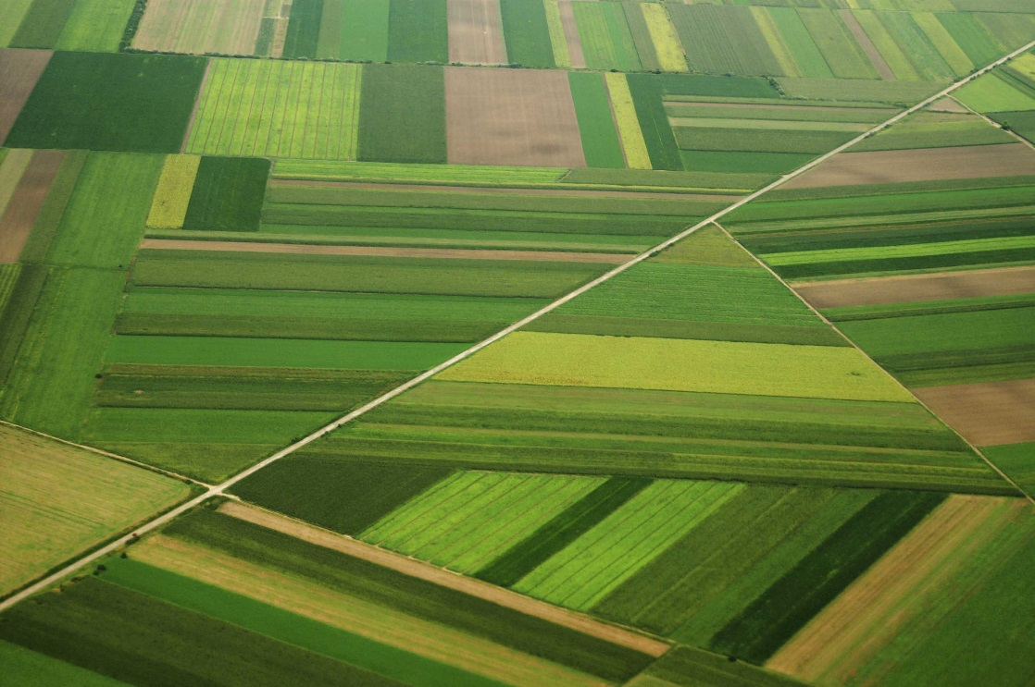
Where Does Your Food Come From?
Plants
Animals
Energy obtained from plants
Animal Products (Milk)

Slide 3
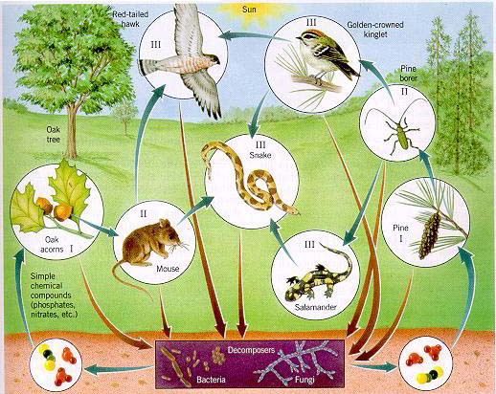
Soils are an Integral Part of any Food Web
Source: http://www.eng.buffalo.edu/shaw/student/m2_design/01_home/ksb/KSB_S2

Slide 4
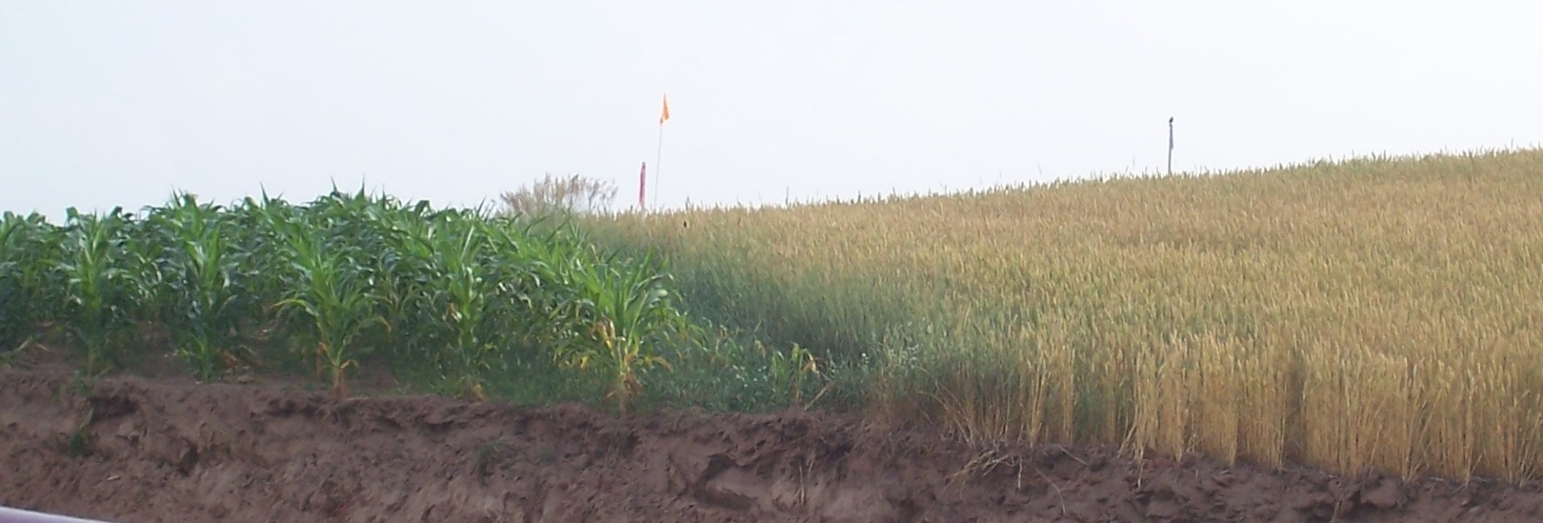
Soil Supports Plants
Water
Nutrients
Biology
Symbiotic Relationships
Bacteria
Fungus

Slide 5
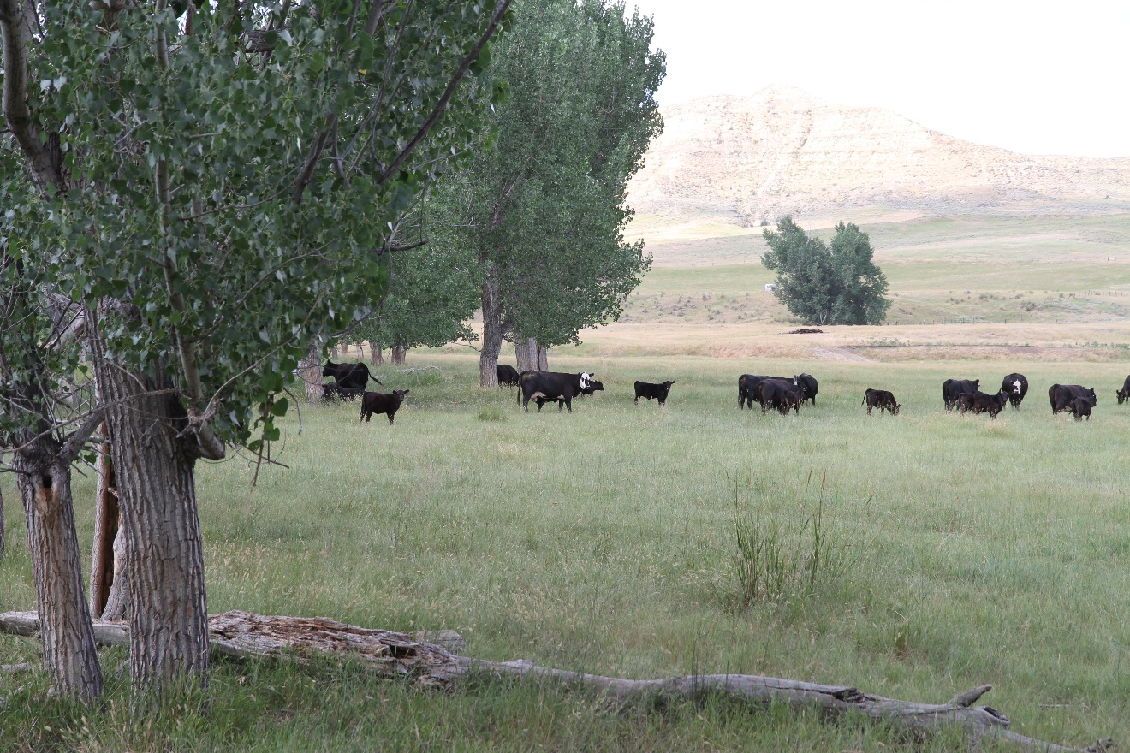
Soil Supports Animals
Grass
Cattle
Sheep
Bison
Wildlife
Row Crops
Pigs
Chickens
Vegetables
Humans

Slide 6
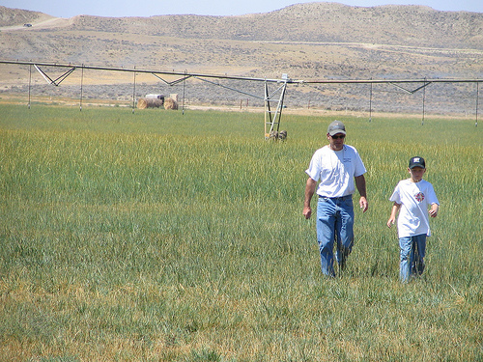
Farmers Support Soils
One US Farmer Feeds About 155 People
Average Farm in US is 455 acres (NASS, 2006)

Slide 8
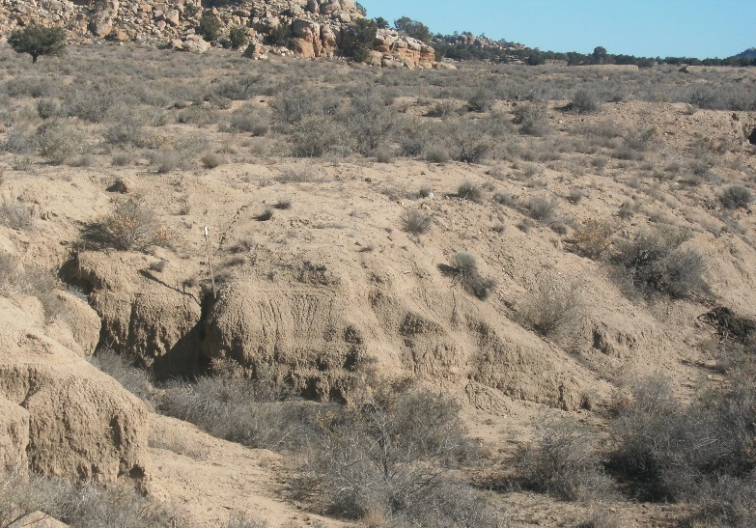
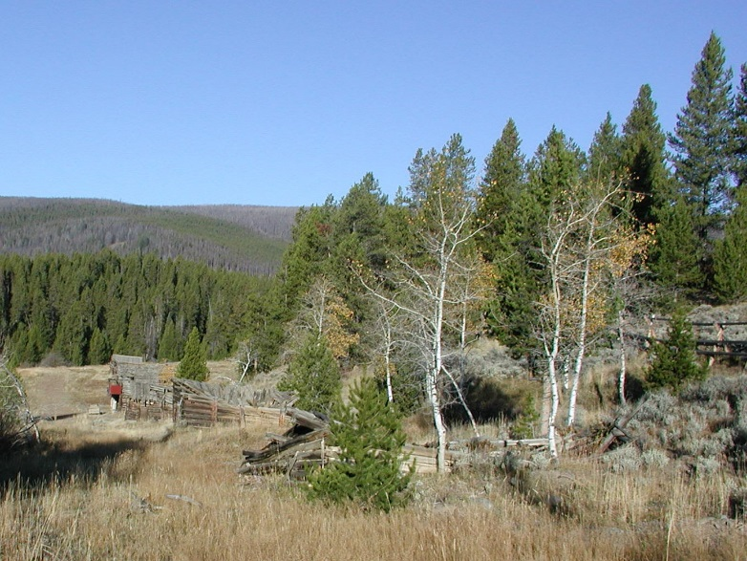
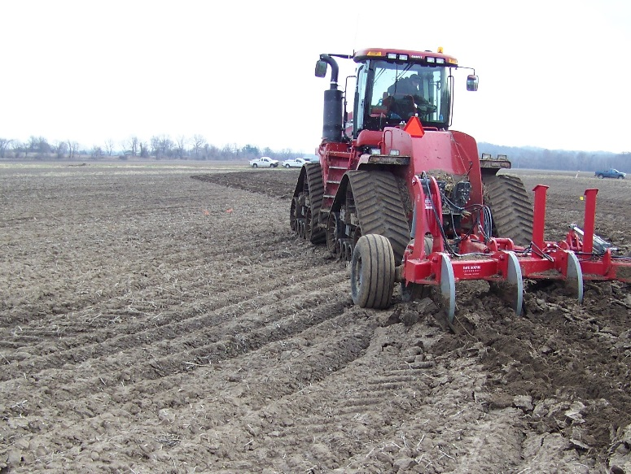
Available Soil
The total land area of the world exceeds 13 billion hectares
Less than half can be used for agriculture, including grazing.
1.4 billion hectares - is presently suitable for growing crops.

Slide 9
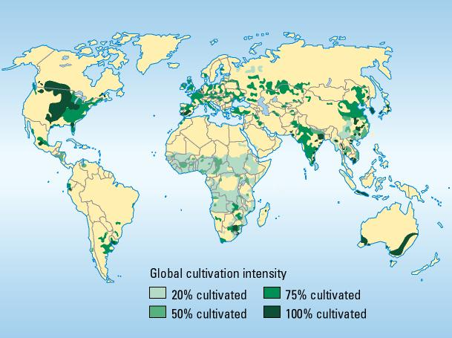
Arable Land
Arable Land is land under temporary, temporary meadows for mowing or for pasture, land under market or kitchen gardens, and land temporarily fallow.
Source: http://myweb.rollins.edu/jsiry/EarthMaps.html

Slide 10
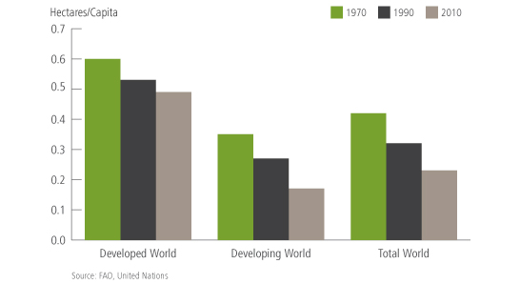
Arable Land
Increase in World Population
Increase in Urban Areas
Land degradation
Soil is a slowly renewable resource

Slide 11
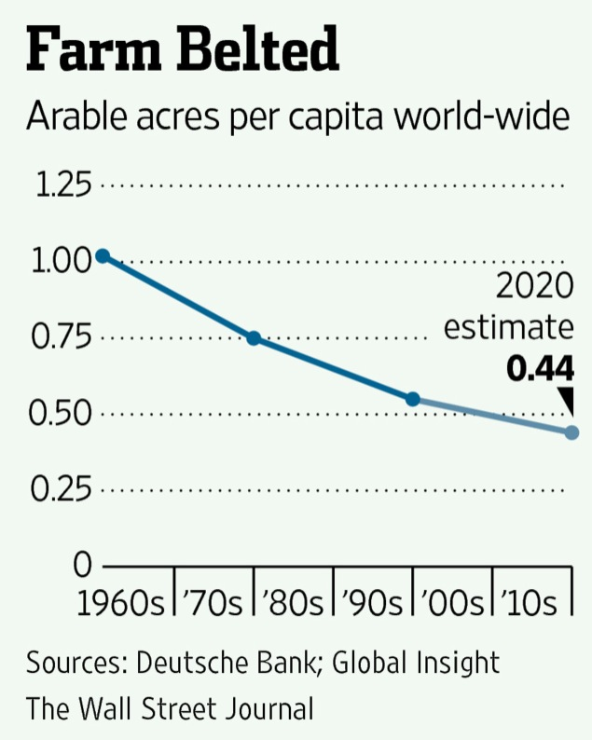
Arable Land
Only 10% of the World Soils can be used for Food Production
1/3 of arable land has been lost to erosion since 1950
30% of US agricultural land been lost due to degradation
Erosion
Salinization
Waterlogging

Slide 12
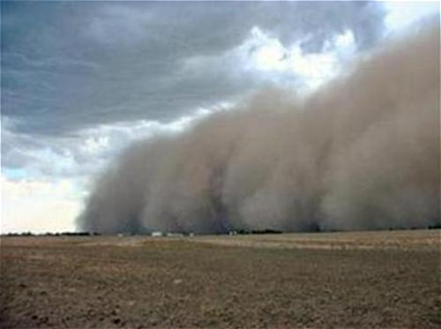
Protecting our Soil
25% of world agricultural soils being impacted by water erosion
40% of arable soils in arid regions impacted by wind erosion
Sources: http://agriculture.ks.gov/divisions-programs/division-of-conservation/soil-erosion-caused-by-wind

Slide 13
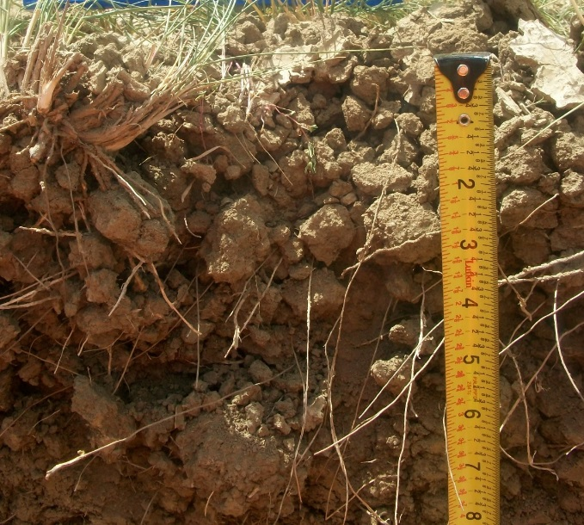
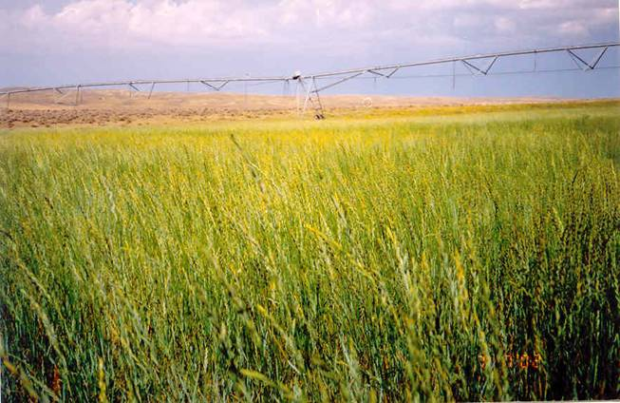
“There are two spiritual dangers in not owning a farm. One is the danger of supposing that breakfast comes from the grocery and the other that heat comes from the furnace.” Aldo Leopold

Slide 14
Sources
http://education-portal.com/academy/lesson/what-is-the-green-revolution-definition-benefits-and-issues.html#lesson – Green Revolution
http://www.nrcs.usda.gov/wps/portal/nrcs/detailfull/national/water/quality/tr/?cid=nrcs143_010914 – Soil Salinity References
http://nass.usda.gov/Charts_and_Maps/Farms_and_Land_in_Farms/fncht6.asp

Slide 15
The UN Declared 2015 as the International Year of Soils (IYS) to bring more attention to this important natural resource. The Soil Science Society of America celebrates IYS and is happy to bring you this presentation. We hope you take the time to learn more about soils at the many resources listed at the end of this presentation, as you learn more about how…
Soils Sustain Life

Slide 16
Thank you for listening! For further information, visit:
Soils.org/discover-soils – information about all things soil!
Soils4teachers.org – Lesson plans, activities, etc. for teachers
Soils4kids.org – activities for the K-12 audience
Follow us on facebook.com/iheartsoil
Soils sustain life!

